Slide 1
Project Presentation
www.pandminc.com
Khurram Farooq, Eoin Lynch, Zachary Kiernan

Slide 2
General Overview and System Requirements
We decided to explore the topic area of Business and so, chose a website with a poor design to evaluate and improve.
There were many functional and non-functional System requirements,
The information on the screen continuously disappeared and reappeared this was a major functional requirement.
An important non-functional requirement we noticed was the locating of contact information.

Slide 3
User group, Interaction style, I/O devices
User group
Following user group evaluation we found that our redesigned interface was considerably more comprehendible and therefore achieved greater efficiency.
Interaction style
An important step in interaction style improvement was giving the overall GUI of the website more consistency which leads to more effective response time by the user.
I/O devices
Selecting I/O devices was an easy decision, we opted for mouse, keyboard and monitor as these are more widely used by users and are more commonly understood than newer options of input/output such as touchscreen.

Slide 4
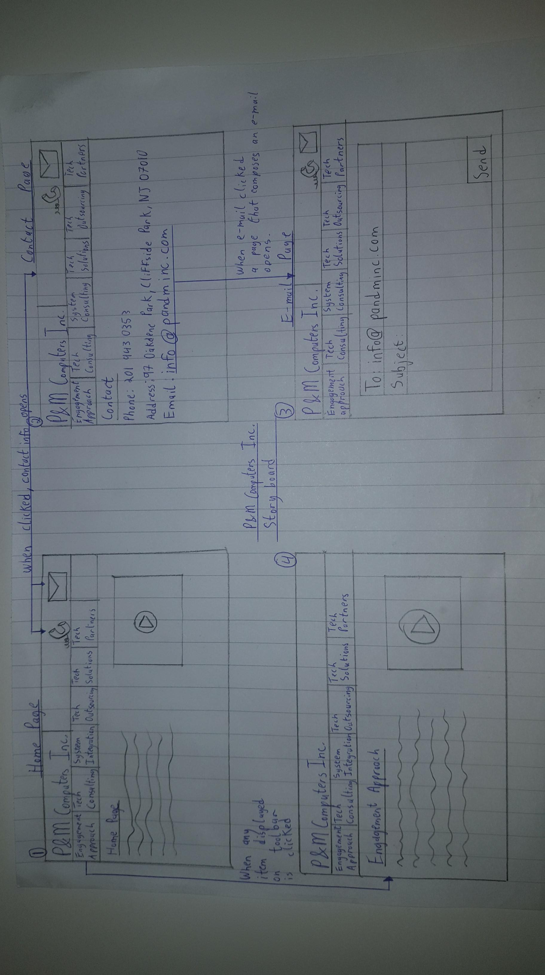
Low Fidelity Prototype
This is a STORYBOARD prototype.
Describing the contact phone and email page of the website as well as a toolbar redesign.

Slide 5
Evaluation of Low Fidelity Prototype
Following evaluation the design of our low fidelity prototype was found to be greatly more efficient.
Perception was addressed through the erroneous mental model where the loading is independent of no. of times clicked.
Attention was improved by removing the one letter/symbol loading style of the websites original design.
Memory was evaluated with a redesign of the dull symbols and style of the original website.
Learning was improved by engaging a new colour scheme which more coherently splits the information on the page.

Slide 6
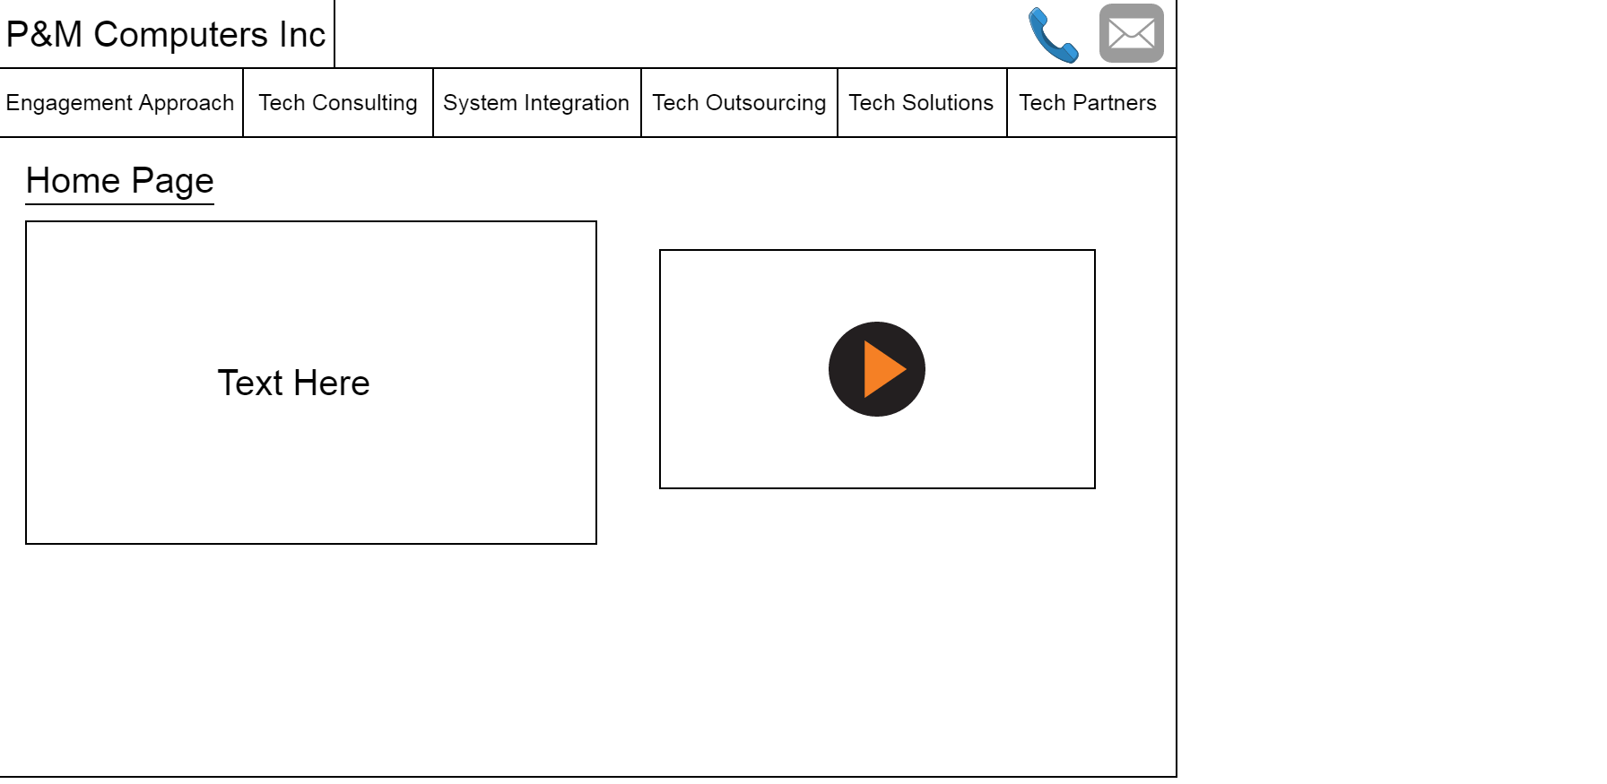
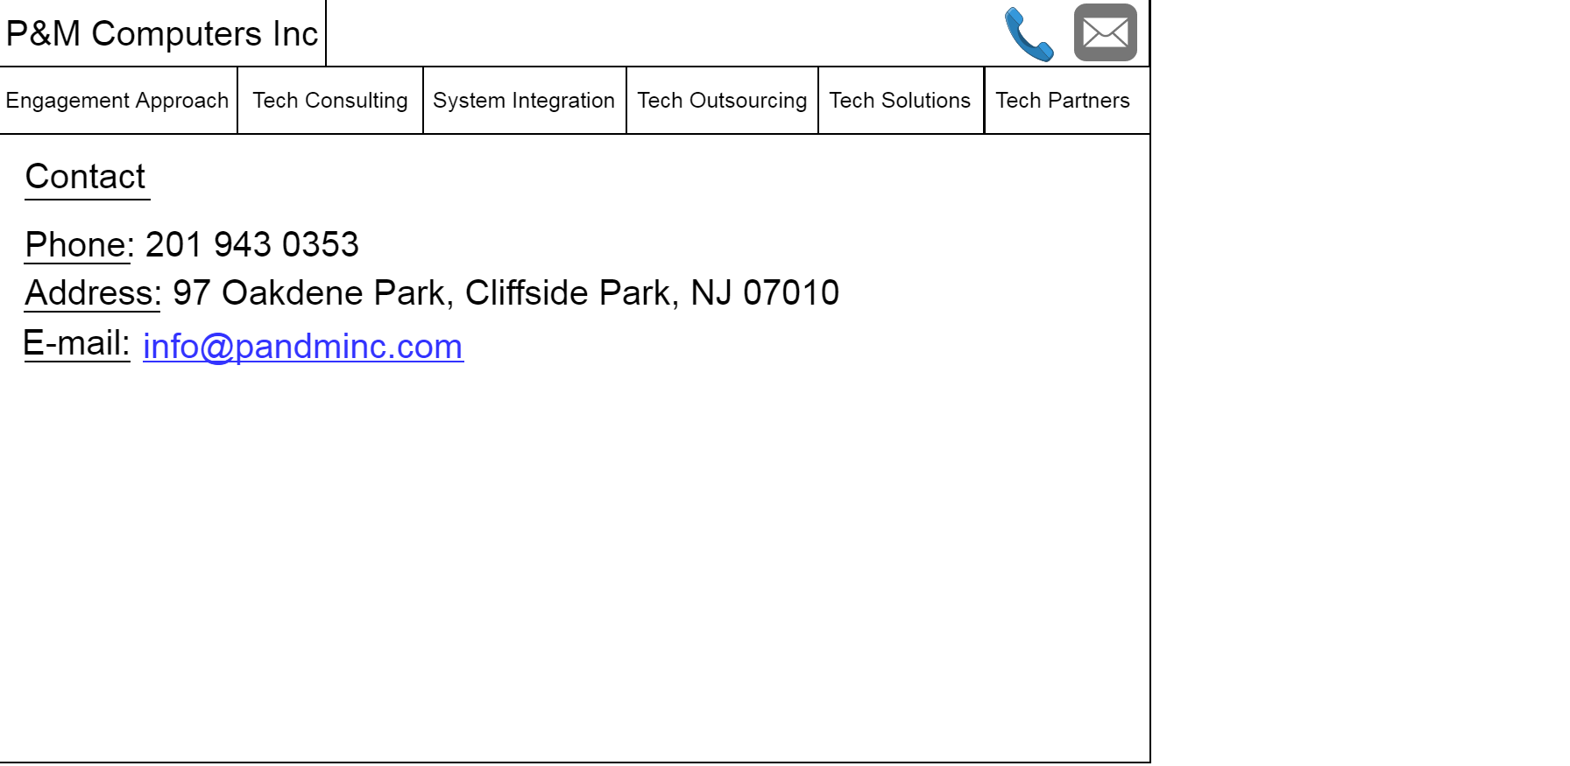
Medium Fidelity Prototype

Slide 7
Evaluation of Medium Fidelity Prototype
To evaluate the medium fidelity prototype, we had other people in the class use the website.
We asked them how easy the site was to navigate and made modifications based on our findings.
Using these guidelines, we found that users found the minimalistic layout of the website very easy to navigate and locate the different pages on the webpage.

Slide 8
Roles Taken by Team Members
Khurram Farooq –
Week 1 Questions
Week 3 Questions
Eoin Lynch –
Week 2 Questions
Week 3 Questions
Zachary Kiernan –
Created the Presentation
Week 3 Questions

